Slide 1

Welcome to the
Recognition of Life Members Day
28th July 2024

Slide 2
Some History
The embers of the current club were lit in the late 1970’s with the formation of the Taylors Lakes Residents Association
The Residents Association were active in giving advice to the developers and Council on matters concerning the growth of the suburb.

Slide 3
The TLRA created a Garden Club activating interest in the new suburbs Community affairs which morphed into a Tennis Club – located at the current site of Taylors Lakes Fresh Food Market.
Tennis moved to the current site with the present rooms in the early 1980’s.
In 1982 the people involved in the new community created a cricket club which played on a mowed paddock near the current Bunnings.

Slide 4
The TAYLORS LAKES RECREATION CLUB became an Incorporated Association in 1984 taking over from the Residents Association.
In 1990 the RecClub created a football club and shortly after that a basketball club.

Slide 5
The RecClub now consisted of Tennis, Football, Basketball, Cricket, Garden and Social Golf Clubs – a growing concern.
Cricket and Football obtained a portable building from the wharf - home for the club for the next 15 years – a lot of internal renovations by members, notably Colin Neilson.

Slide 6
In 2006/7 a new facility was built for Football and Cricket with the portables departing in August 2007.
Football won its first Seniors Premiership in 2010.
Cricket installed a turf wicket in 2011 after winning 3 consecutive Luscombe Shields moving into Sub-District Cricket.

Slide 7
The current main oval lighting was installed in December 2016.
Tennis court surfaces upgrades have occurred on a regular basis since 1990 and the club now has one of the biggest and most professional coaching programmes in the western region of Melbourne.

Slide 8
In 2020 the RecClub changed to the TAYLORS LAKES SPORTING CLUB INC. by vote at the 2019 AGM to better reflect our current organisation.
Football are now the Taylors Lakes Football & Netball Club with our netballers recently winning last season's Grand Final.
A Senior Womens football team also entered the competition this year and are currently vying for a finals berth in their first season.

Slide 9
NEXT
Tennis are commencing their rebuilt to new rooms as of September 2024 – the Council has promised State-of-the-Art, including new lighting and 3 further court upgrades…Yeh!

Slide 10
Basketball are looking forward to the opening of the new facility on the Primary School grounds. This will become a home court for them and their new home base… Double Yeh!
The club will be pushing as hard as possible to see the lighting on the oval upgraded to permit night play…. And lots more…

Slide 11
LIFE MEMBERS
Peter SINCOE
Bruce VERLANDER
Wendy FEELEY
Ross HEATHCOTE
Bobby HUGHES

Slide 12
Ray McMullin
Peter SHAW
Rob STEVENSON
Roberta PADDLE
John ZYLSTRA
Sandra ZYLSTRA
John SMITH

Slide 13
Geoff MORRISON
Liz NEILSON
Colin NEILSON
Brian MILLER
Denis FERNS
Phil CROWE
John RUMBELOW

Slide 14
John STACEY
Peter McKERNAN
Ray MARSHALL
Ian ROBSON
Glen FRANZI
Rob ARNOLD

Slide 15
…AND ALL THEIR PARTNERS AND FAMILIES OVER THE LAST 40 YEARS.
WE SAY THANK YOU TO ALL OF THEM.
NOW FOR SOME MEMORIES..

Slide 16
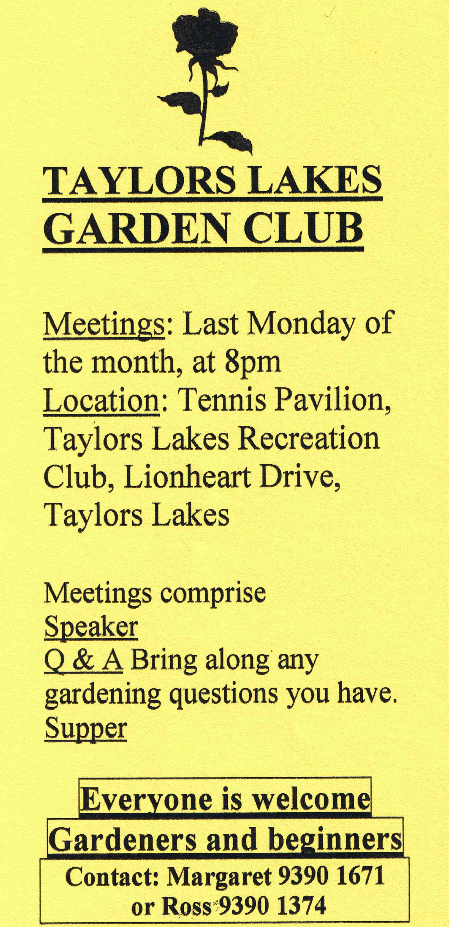
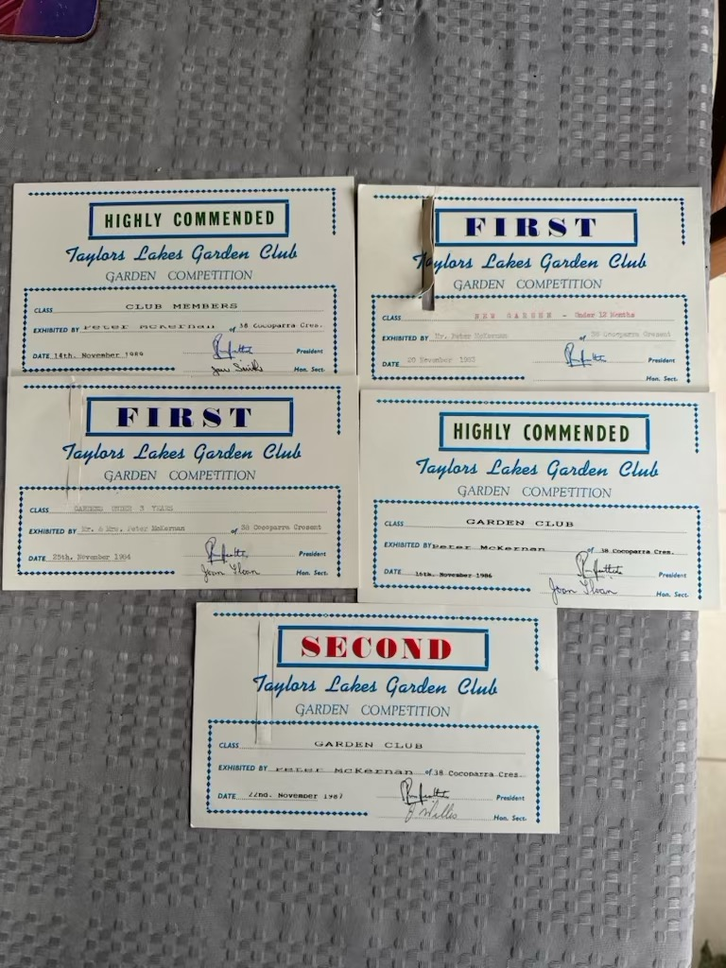

Slide 17
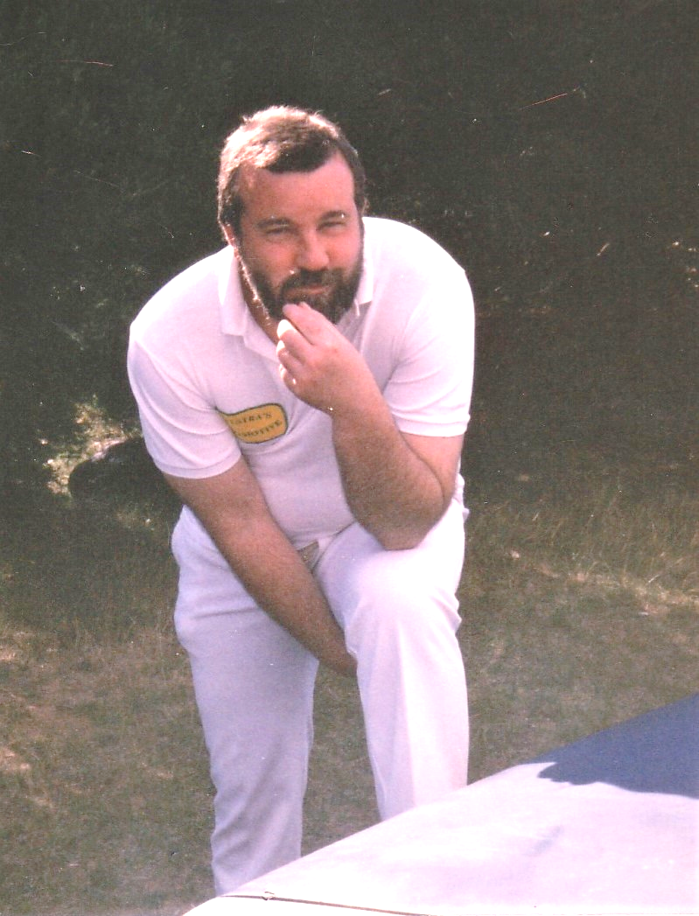
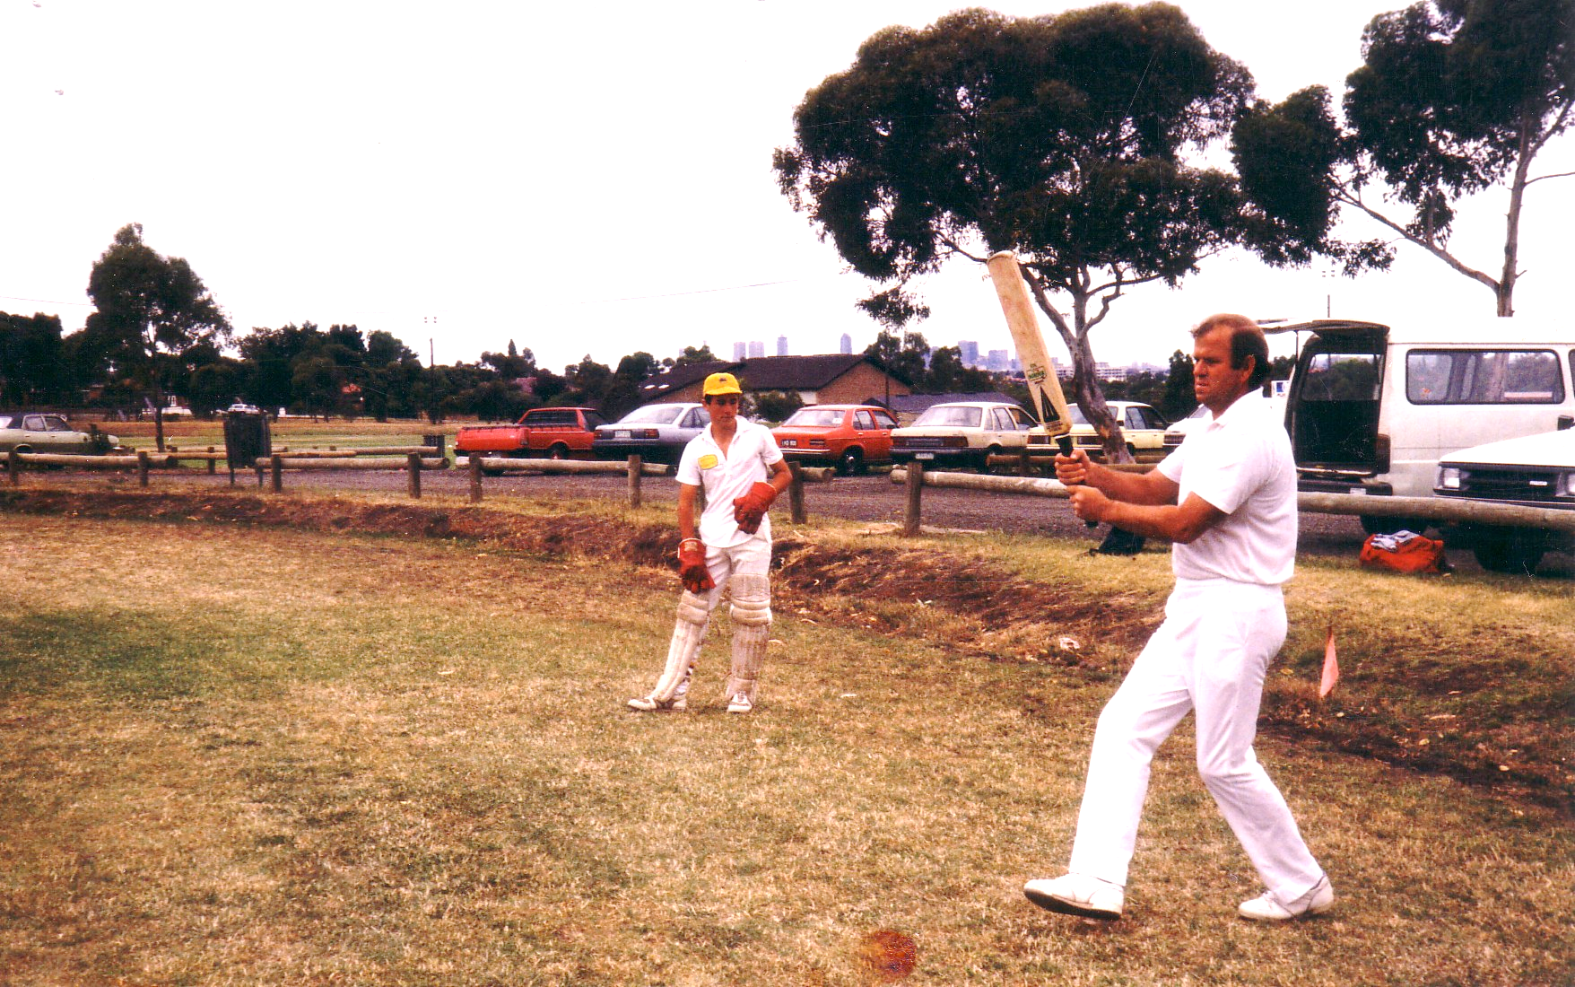

Slide 18
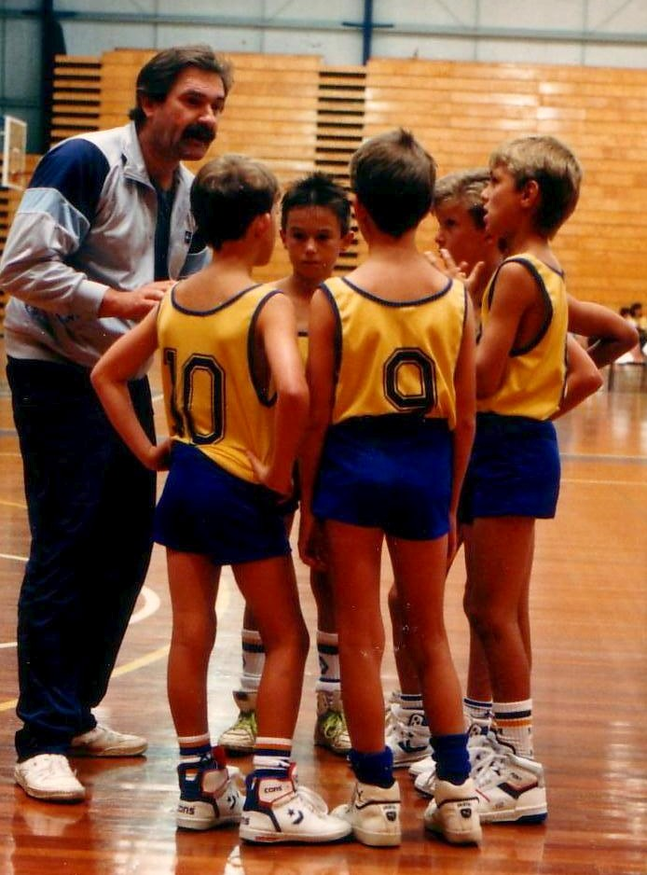
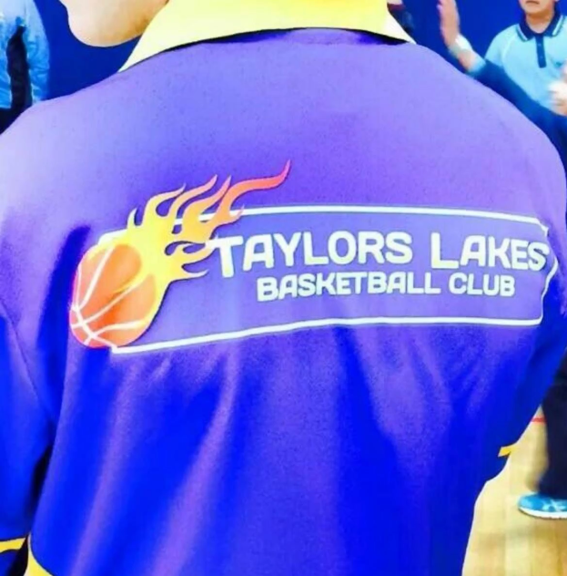

Slide 19
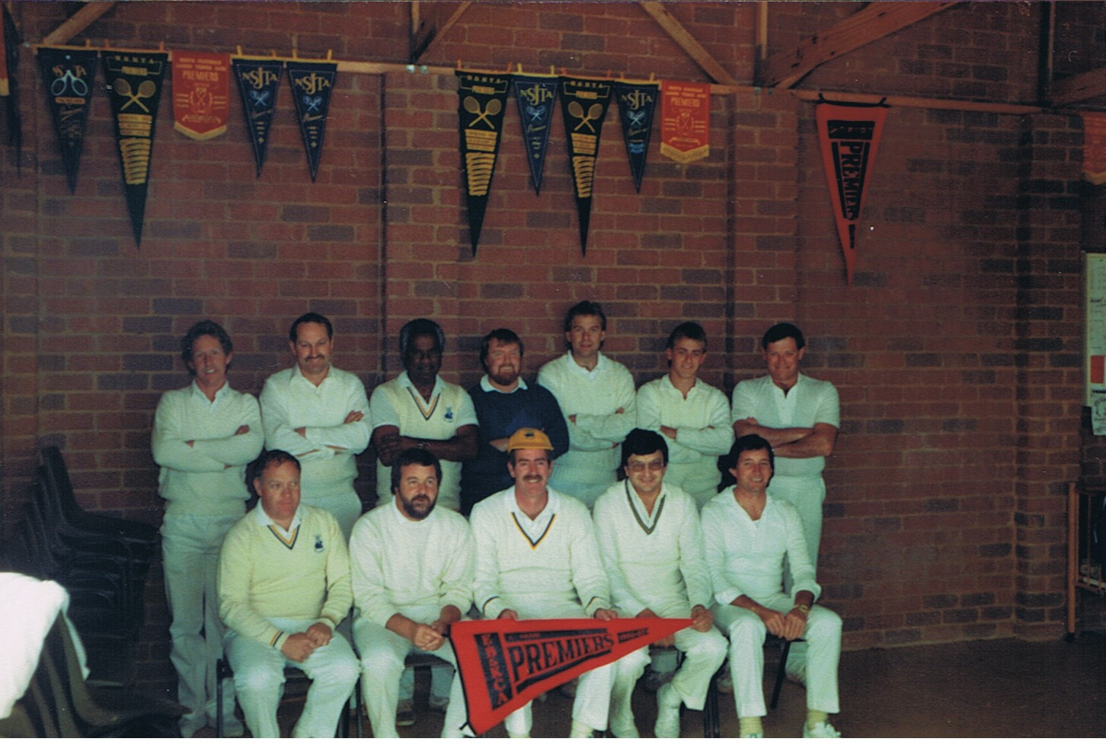
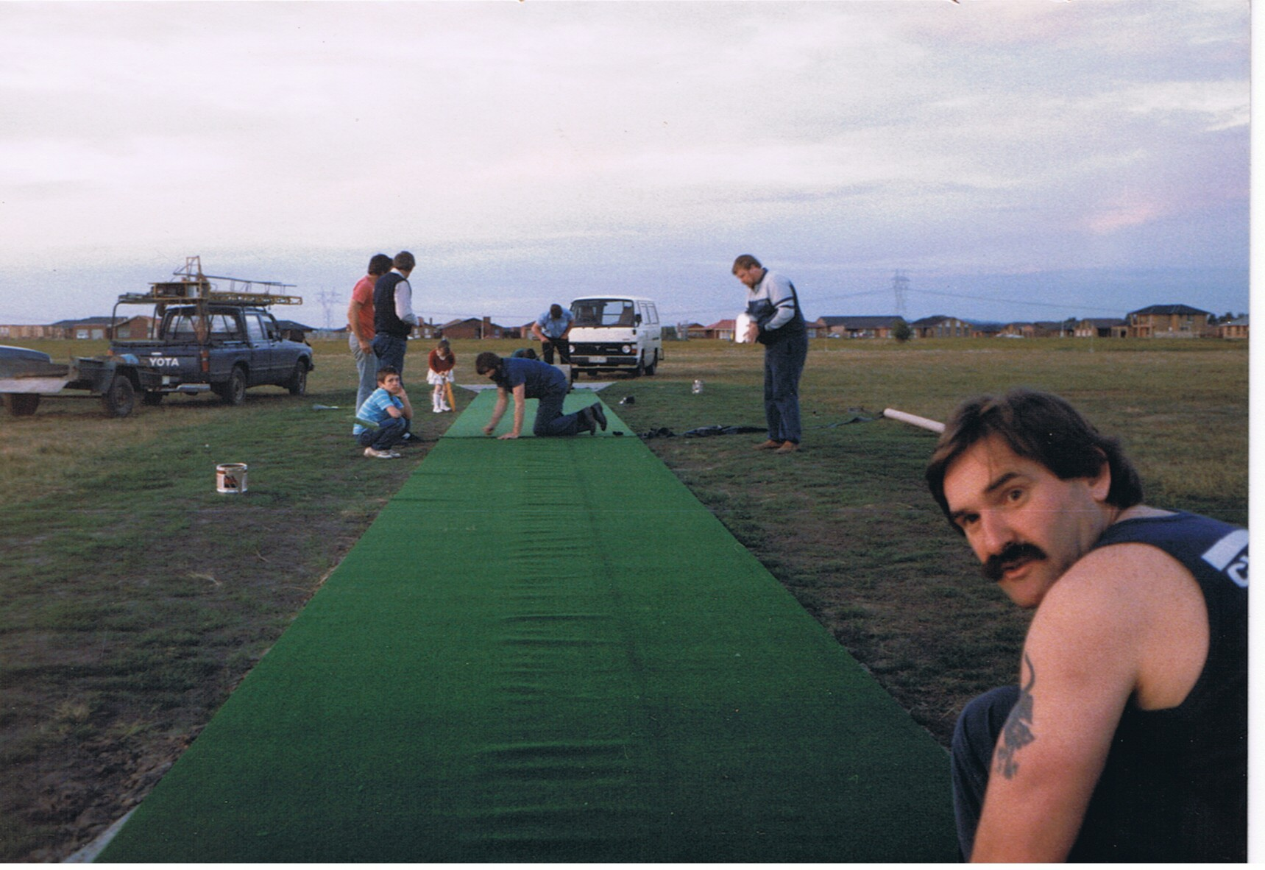
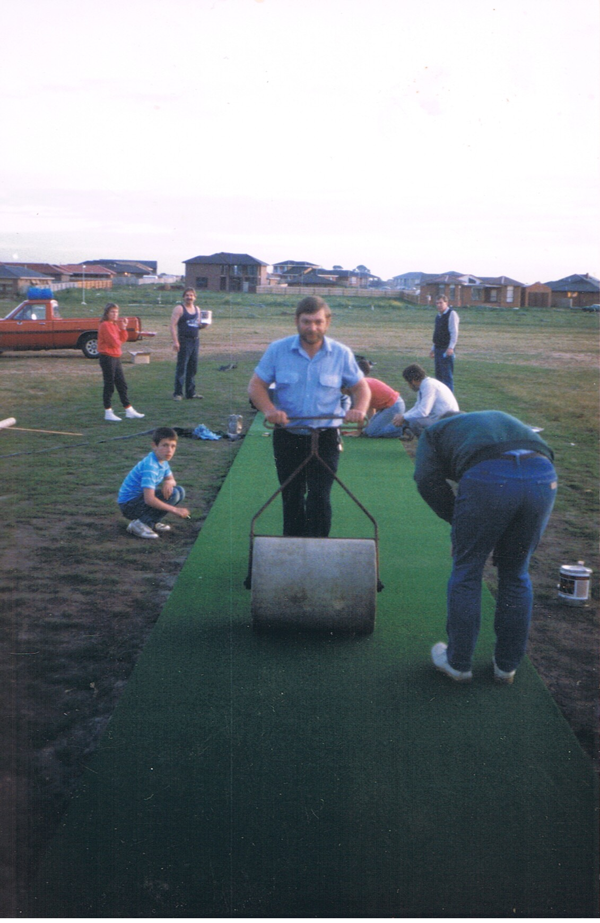

Slide 20
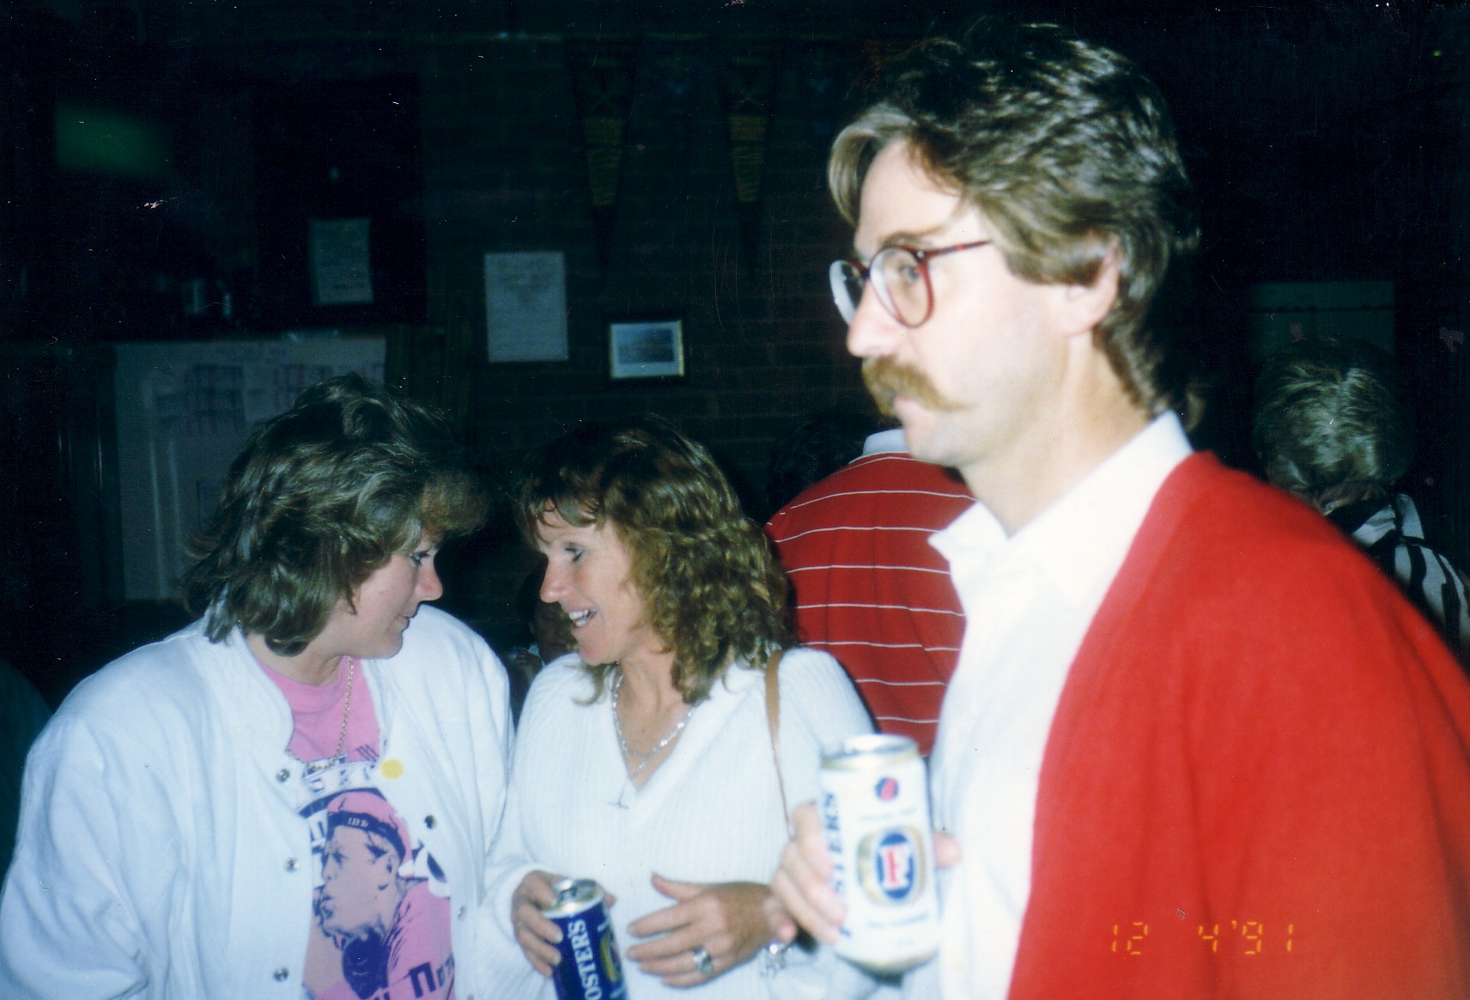
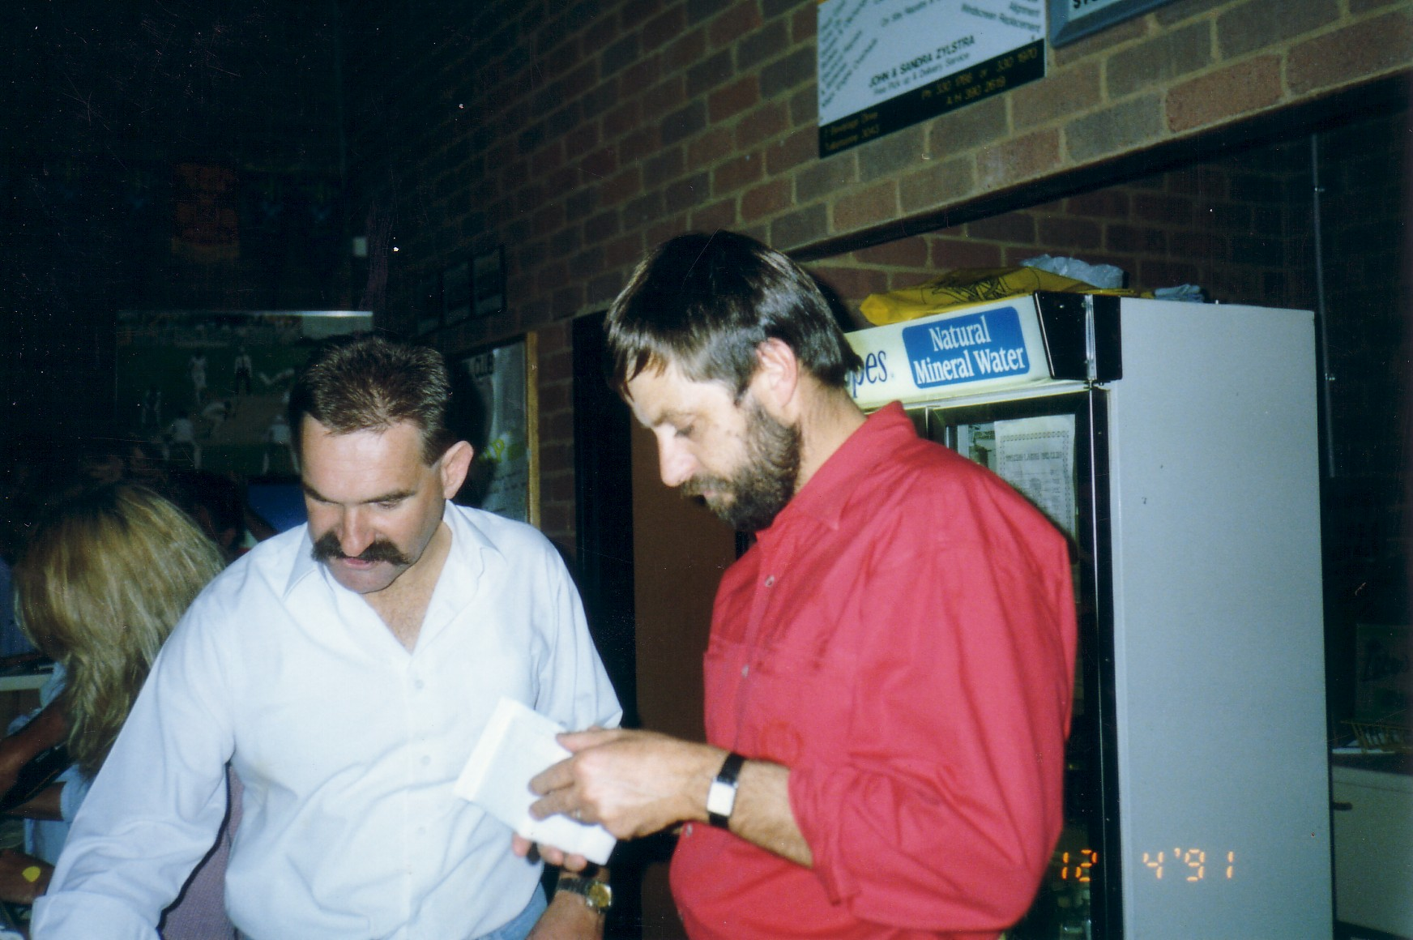
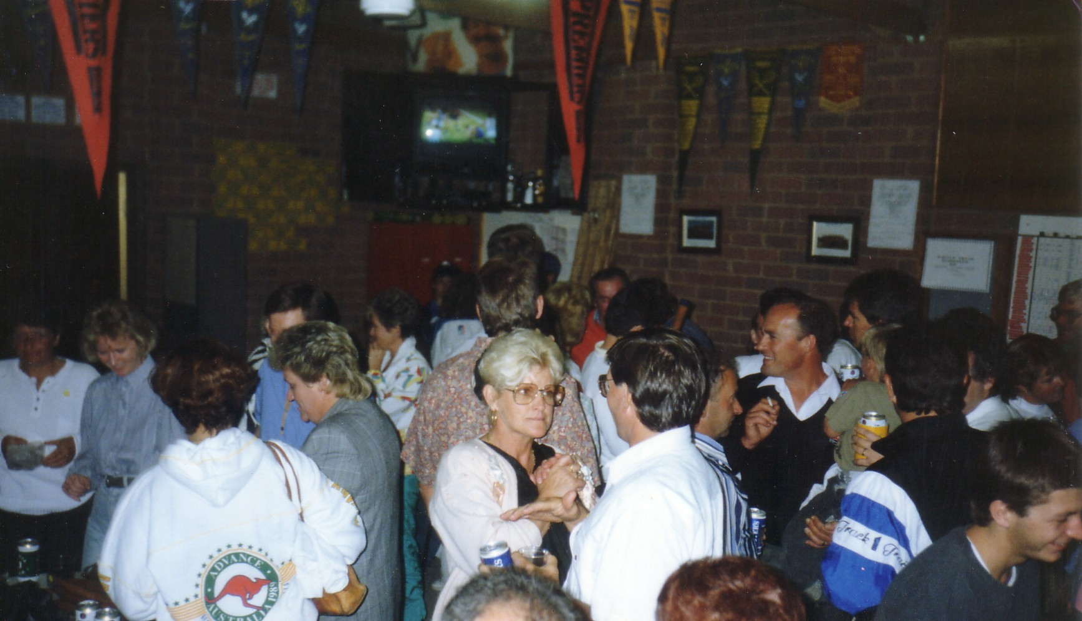
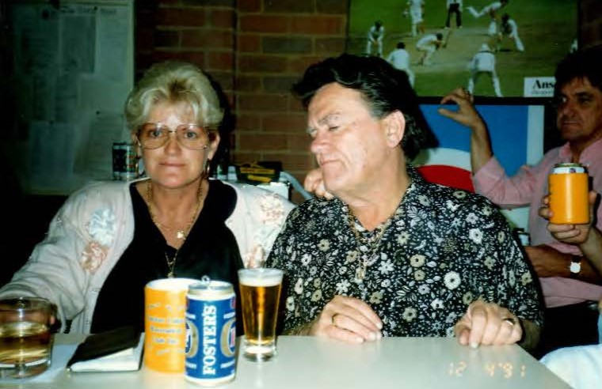

Slide 21
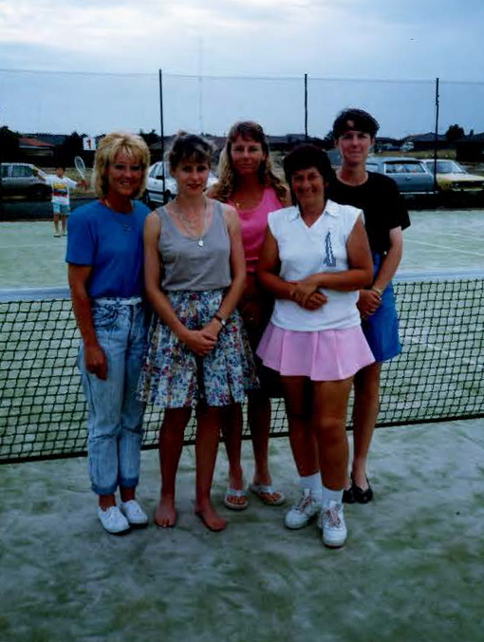
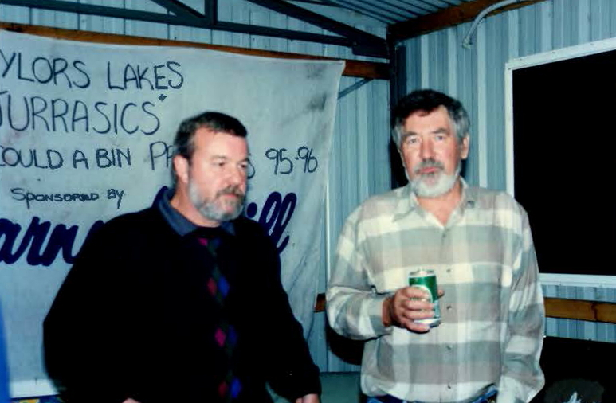
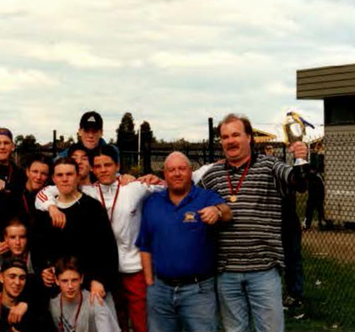
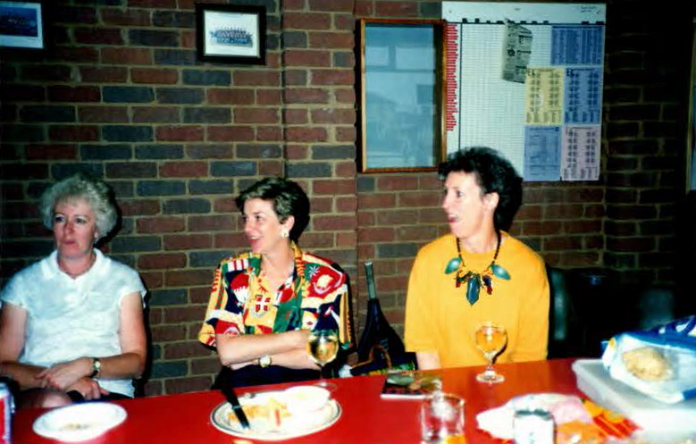

Slide 22
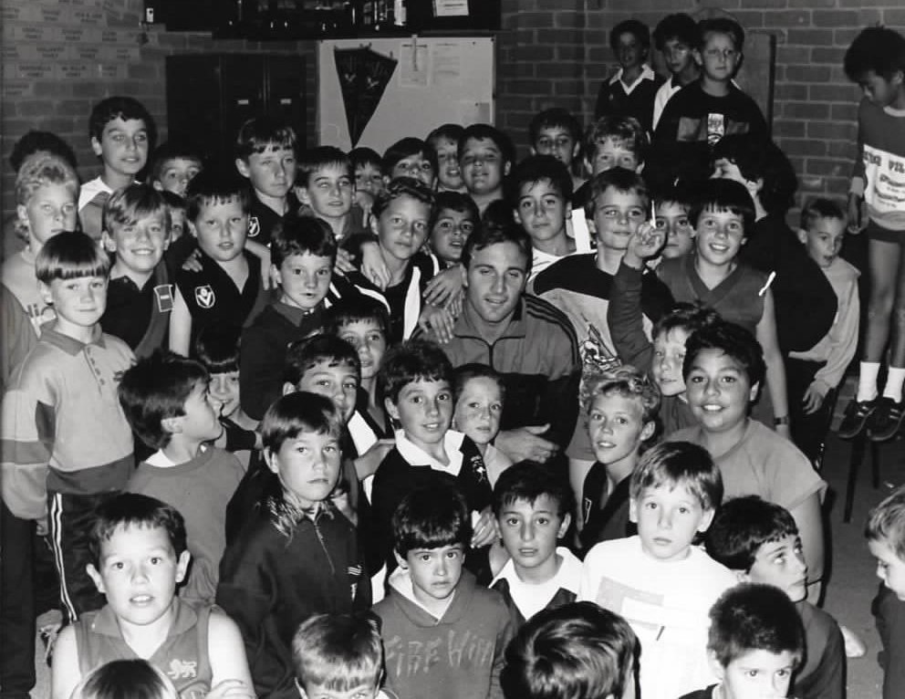
Tim Watson with our first Footballers 1990

Slide 23
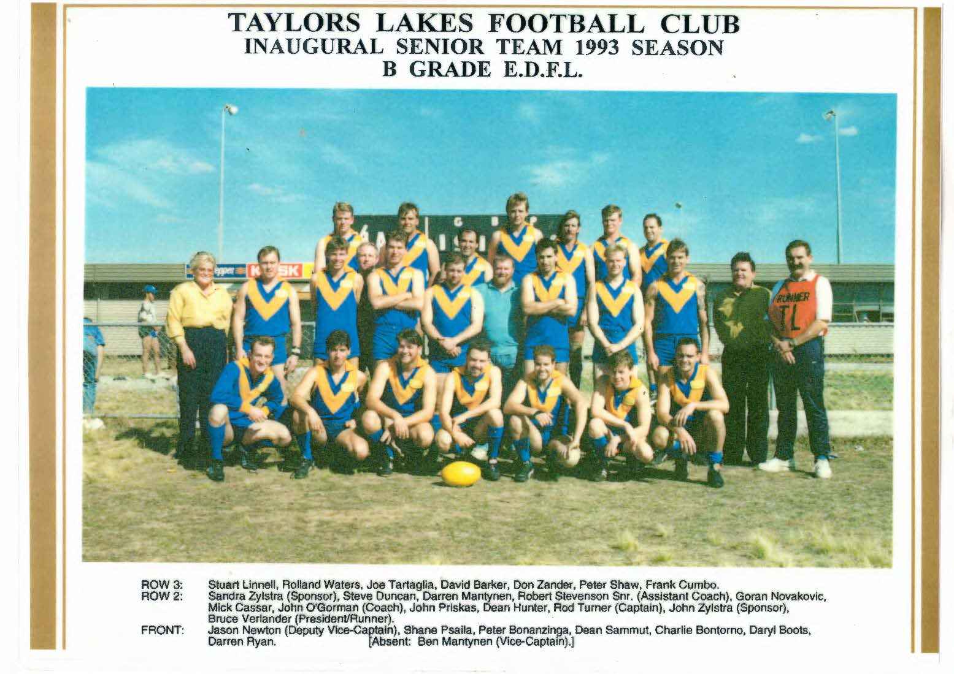
FEATURING:
Peter Shaw
Rob Stevenson
John Zylstra
Sandra Zylstra
Bruce Verlander

Slide 24
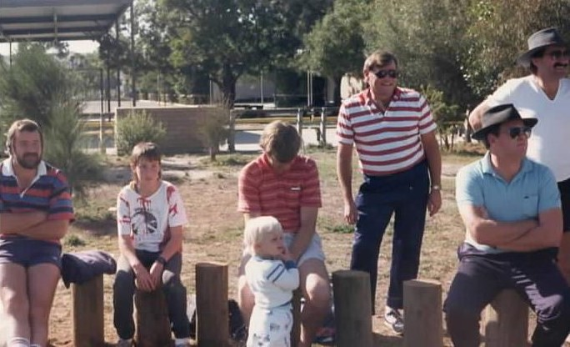
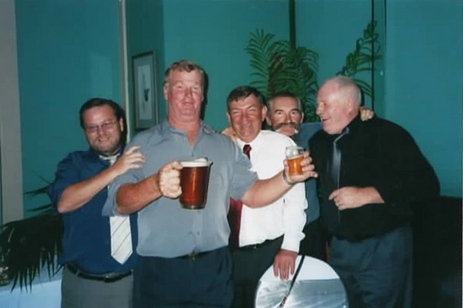
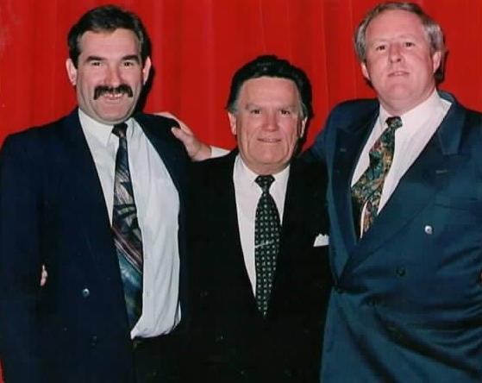

Slide 25
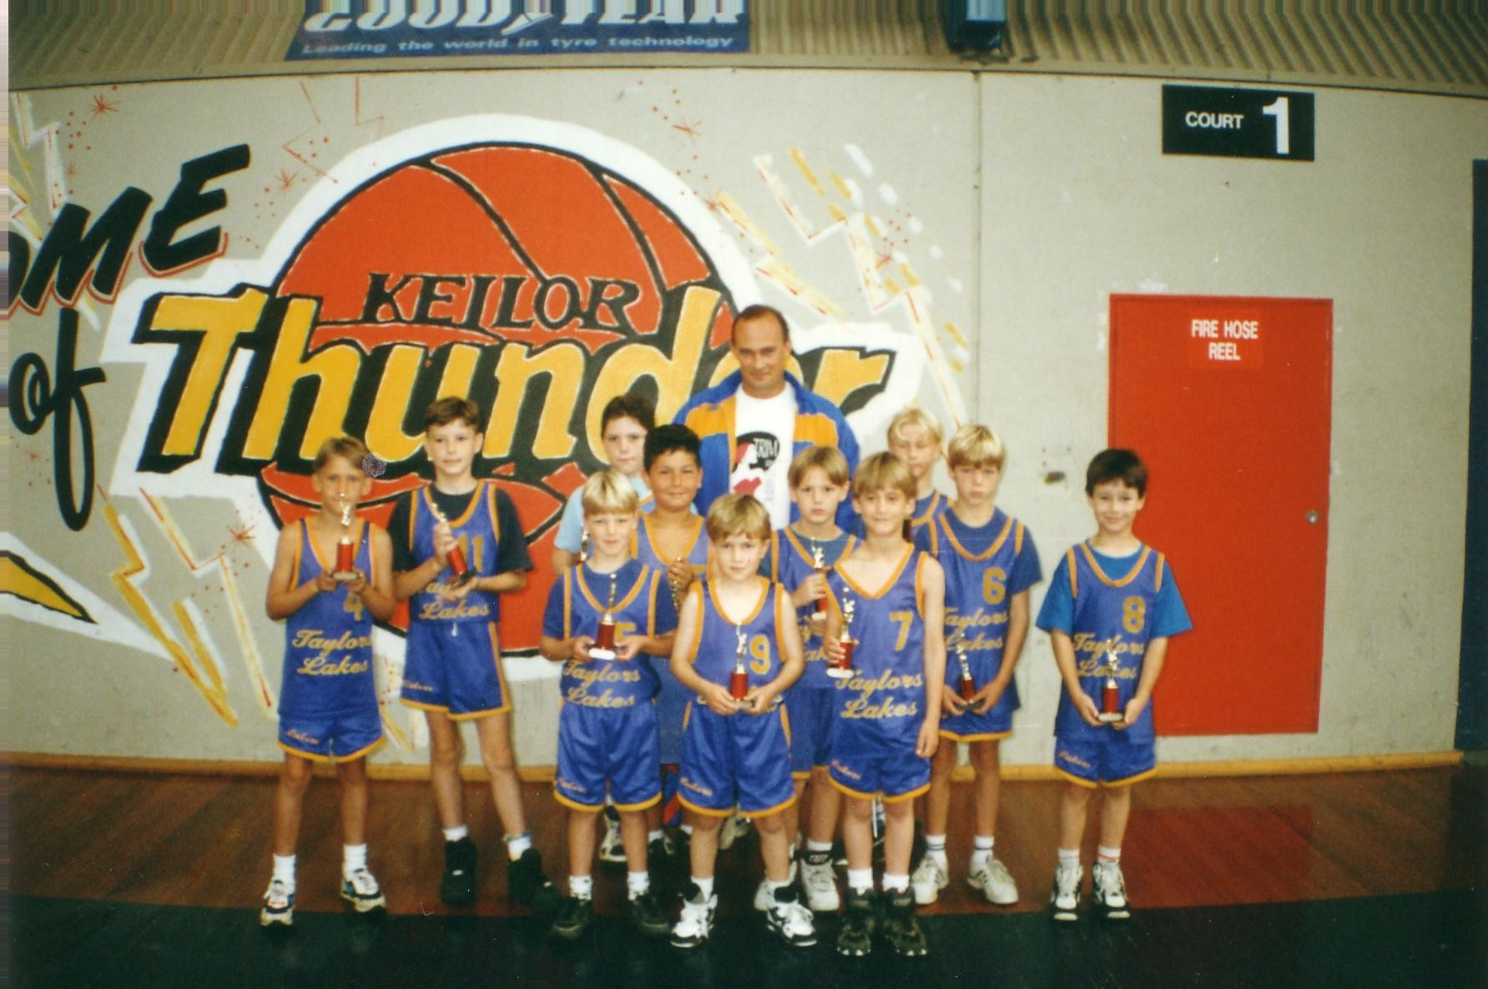
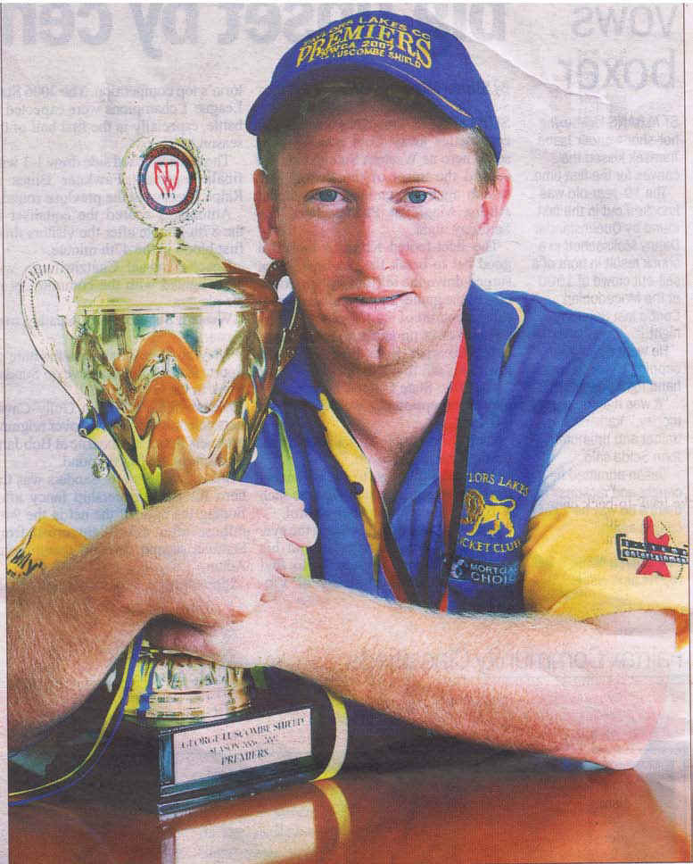

Slide 26
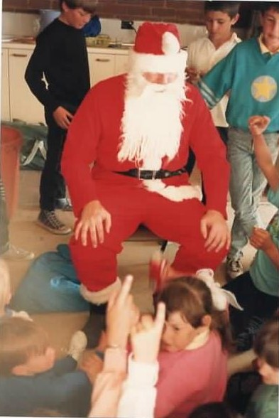
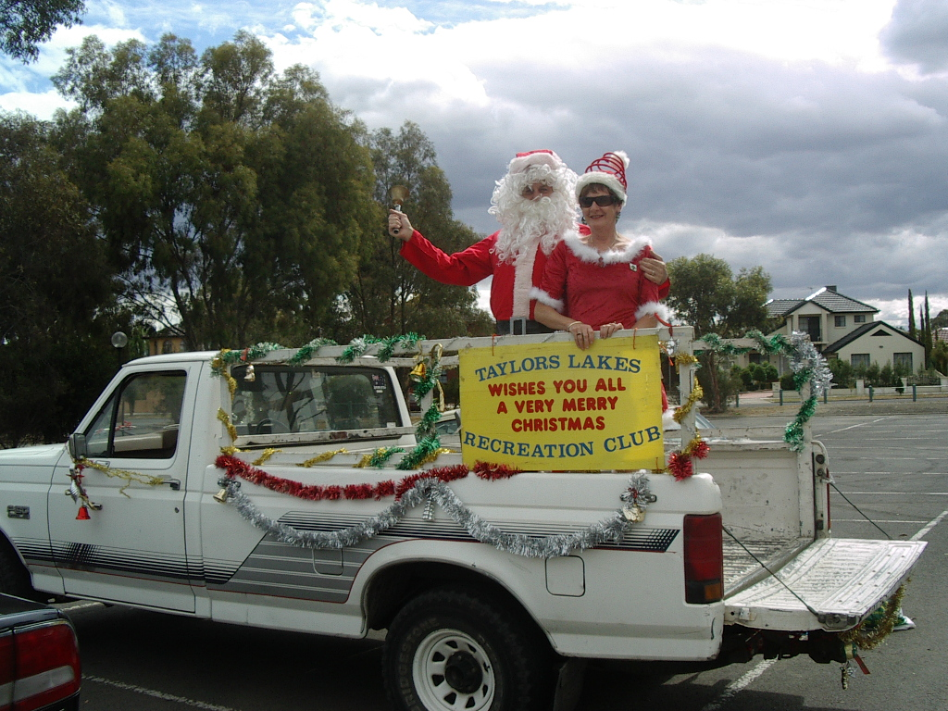
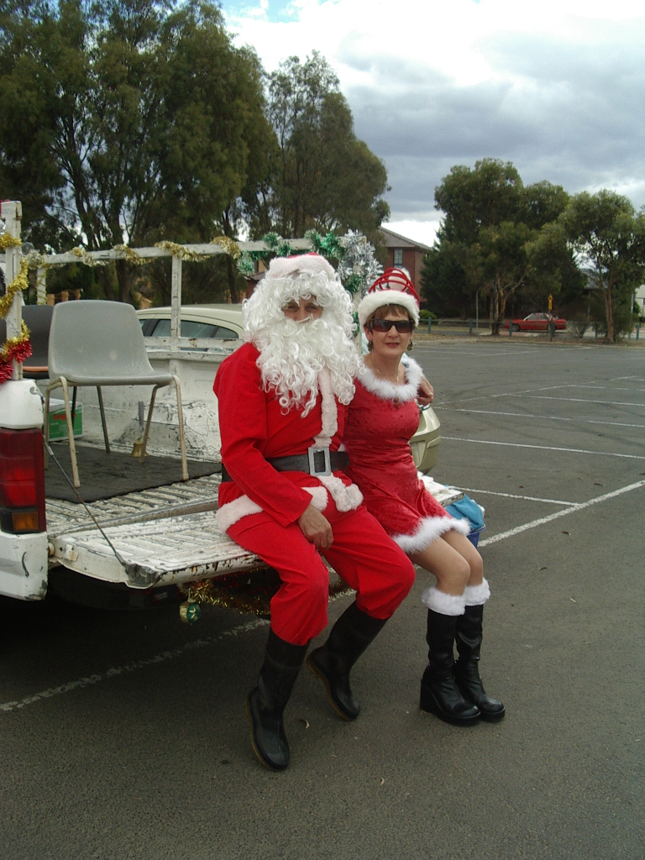
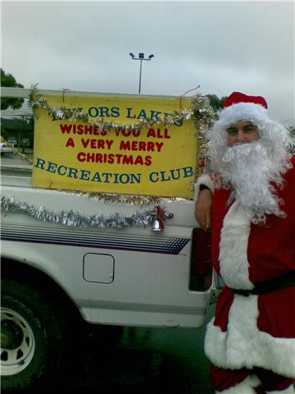
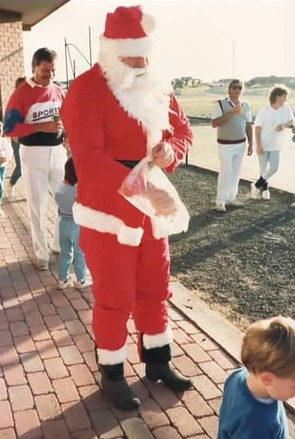

Slide 27
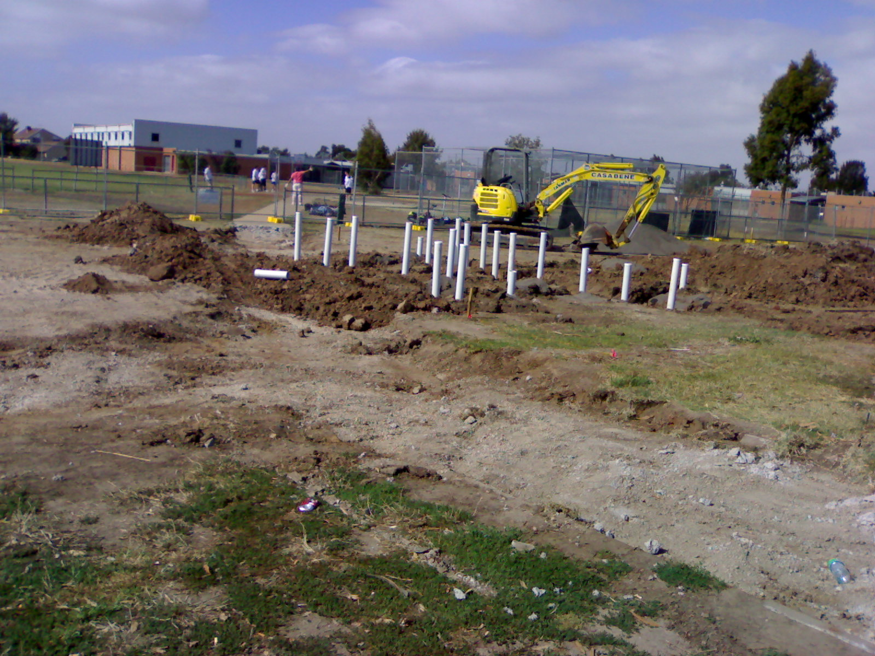
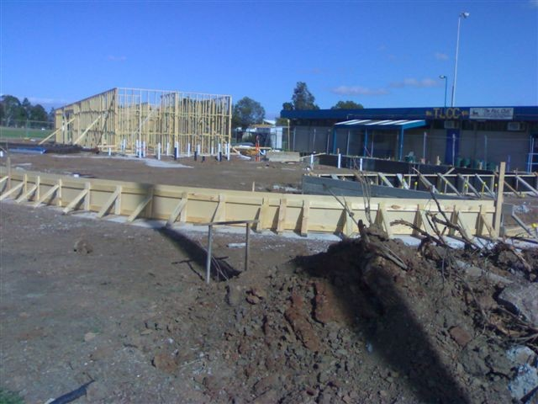
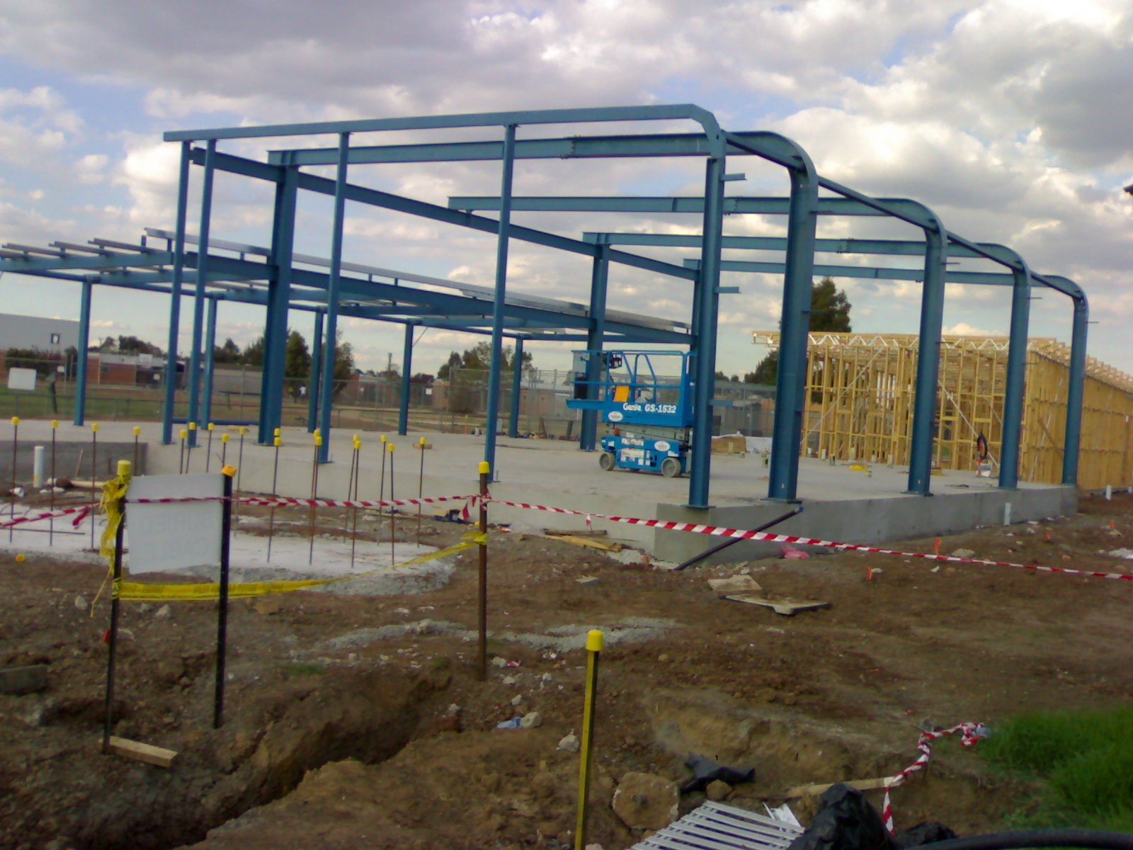
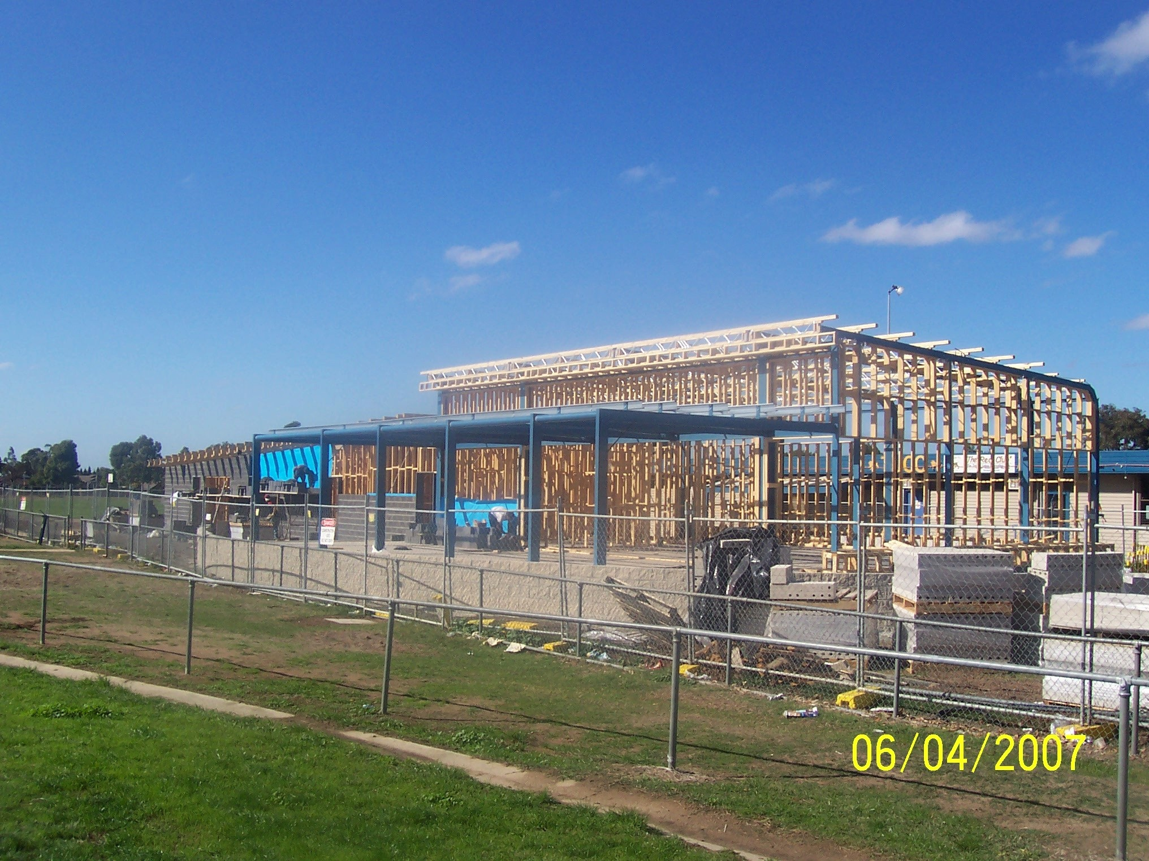
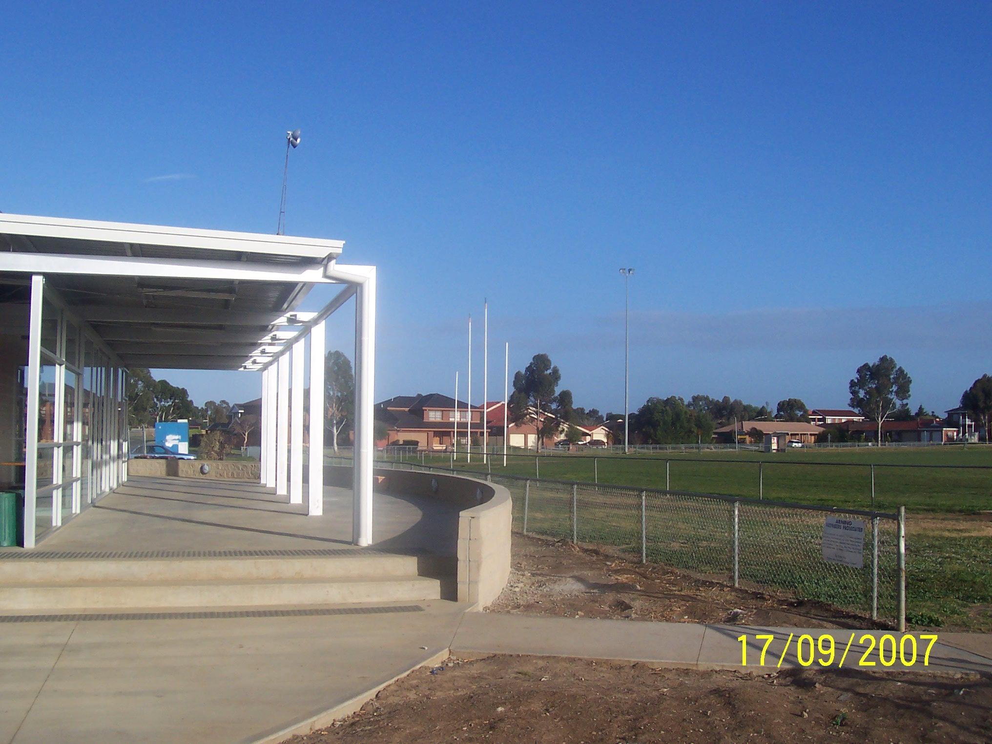

Slide 28
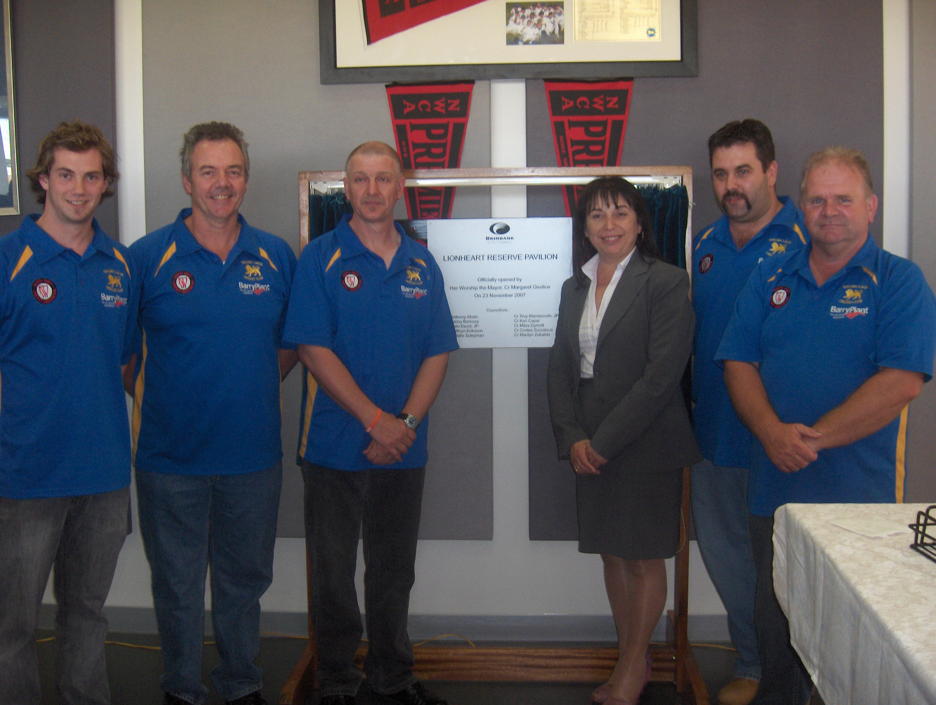
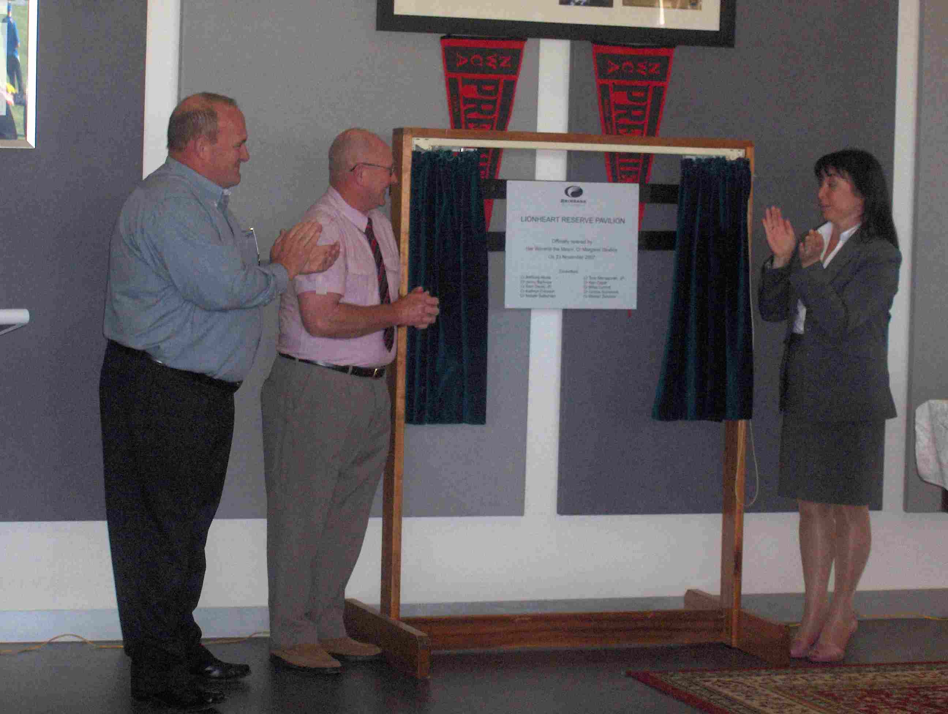

Slide 29
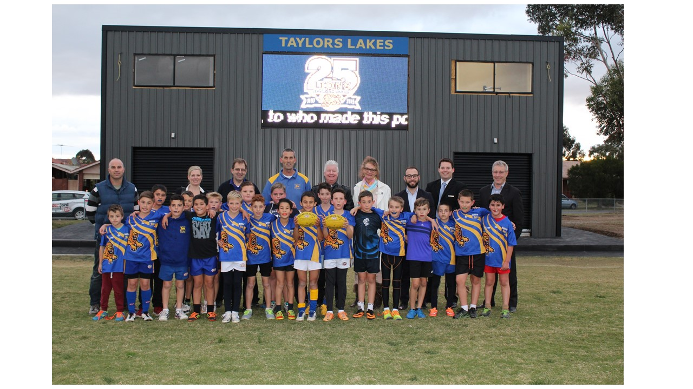
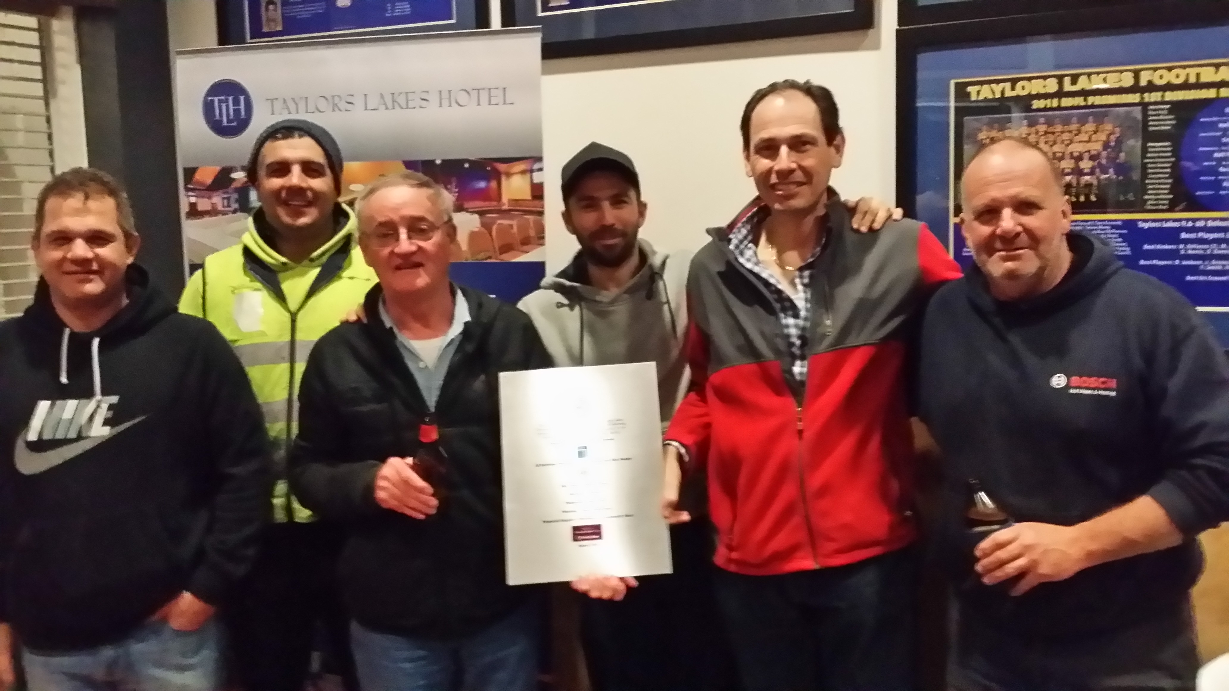
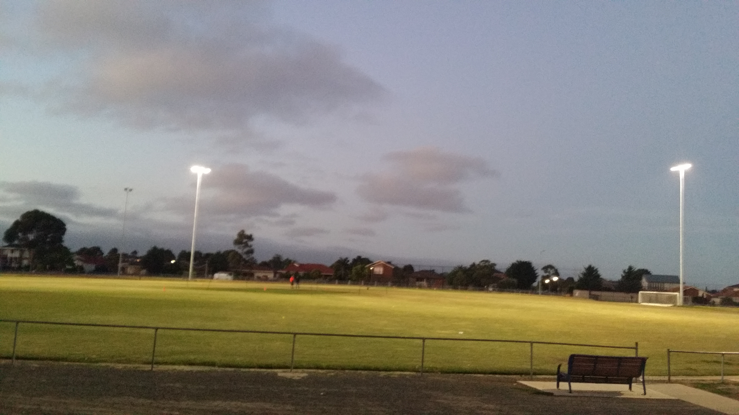

Slide 30
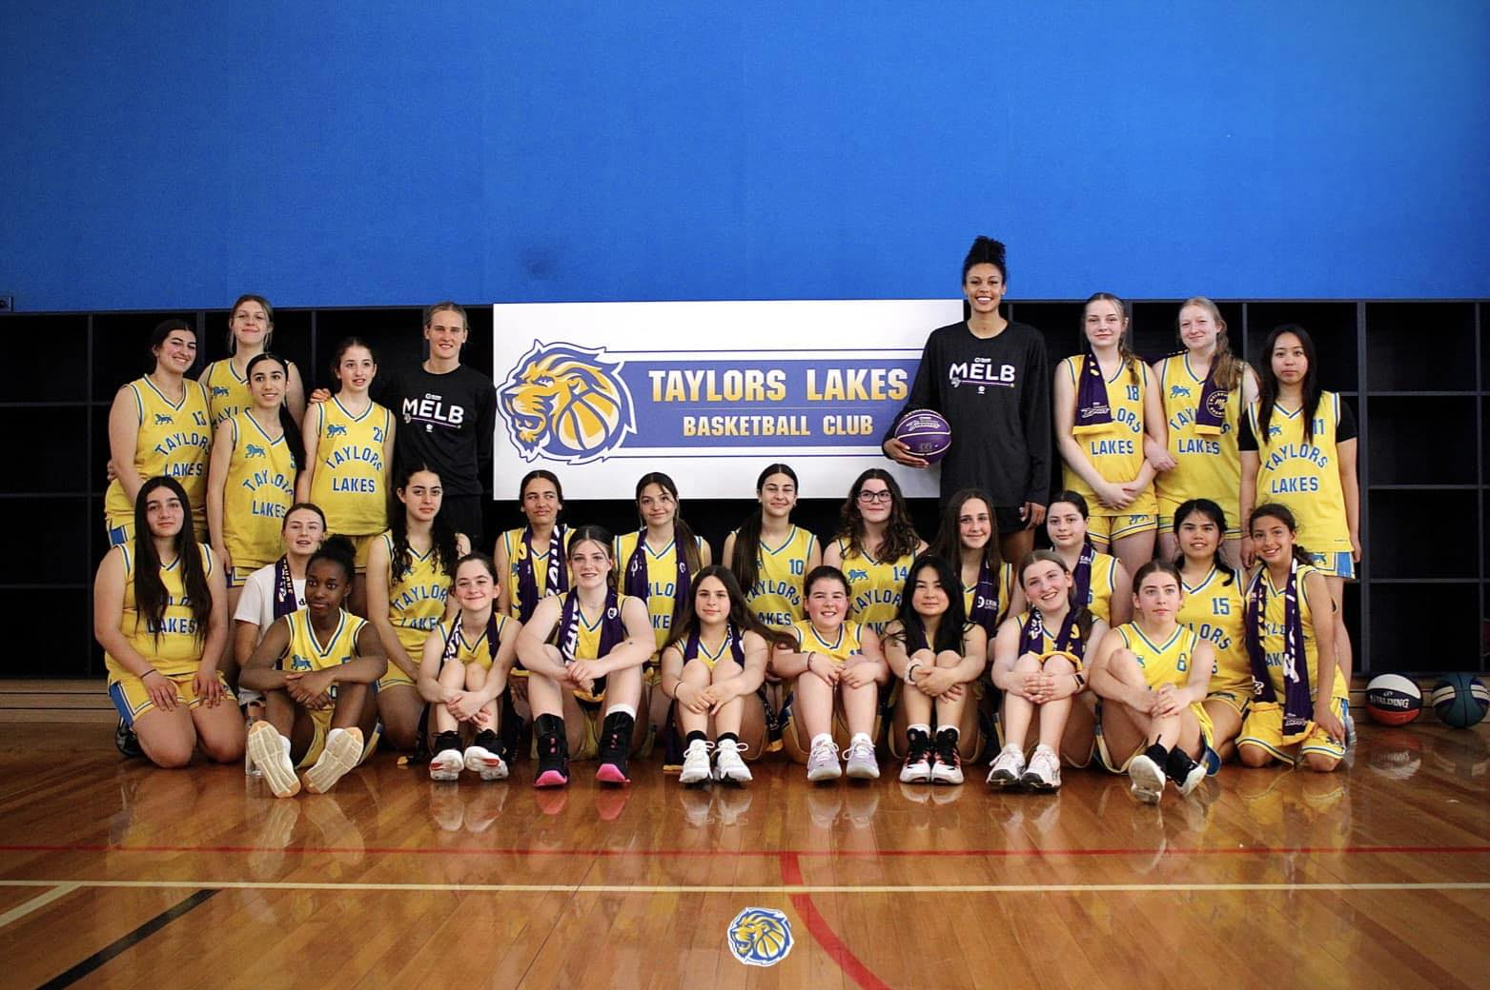
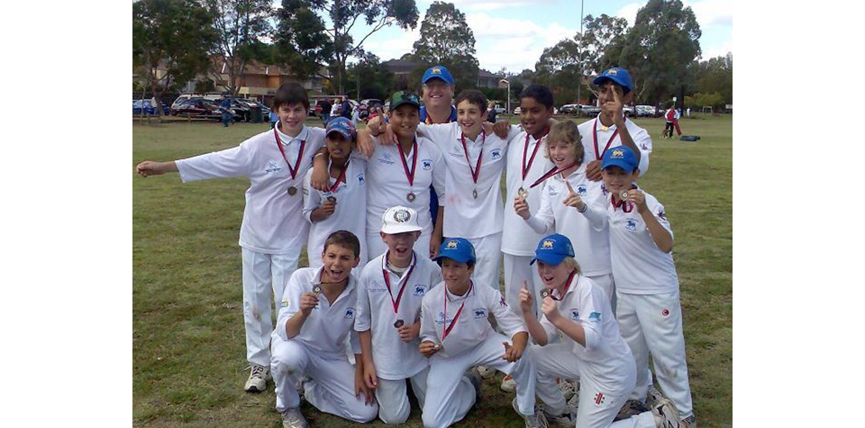
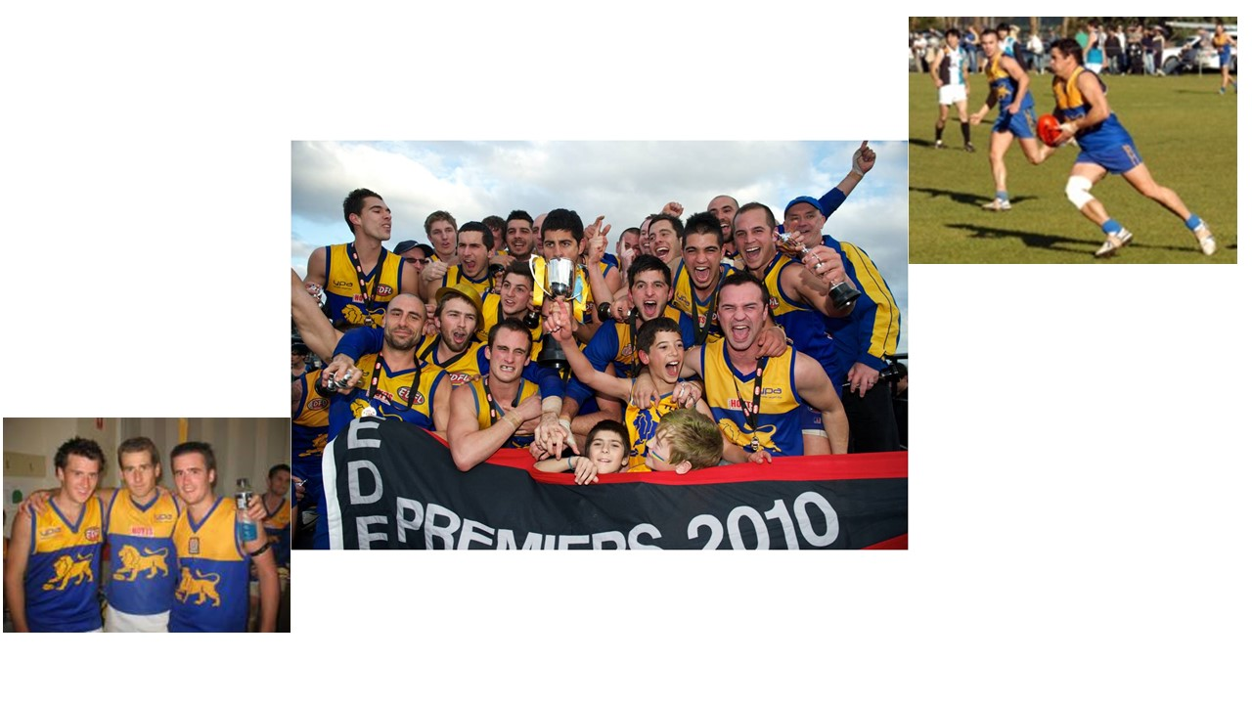
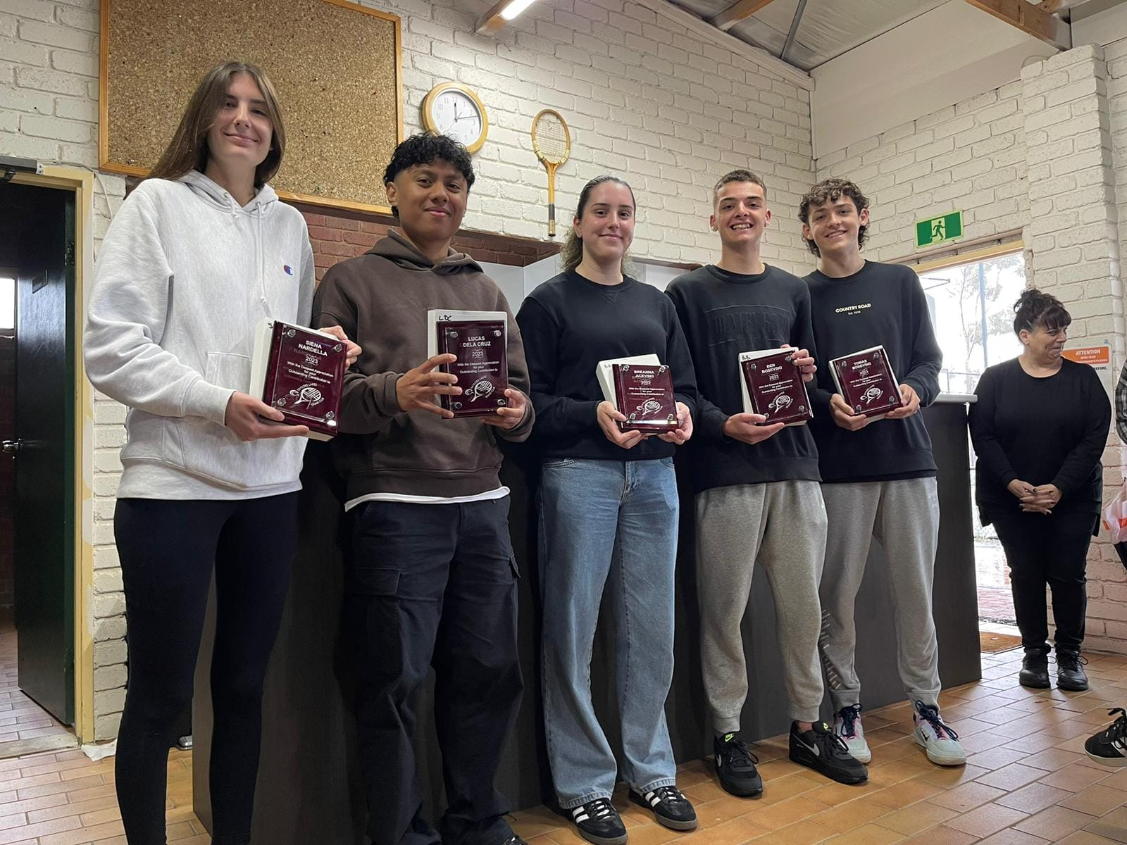

Slide 31
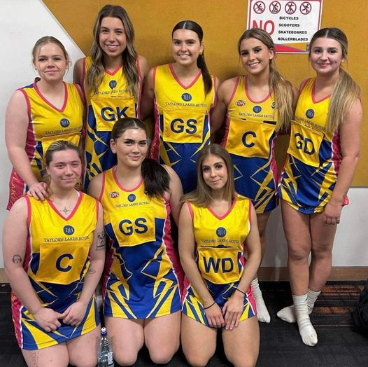
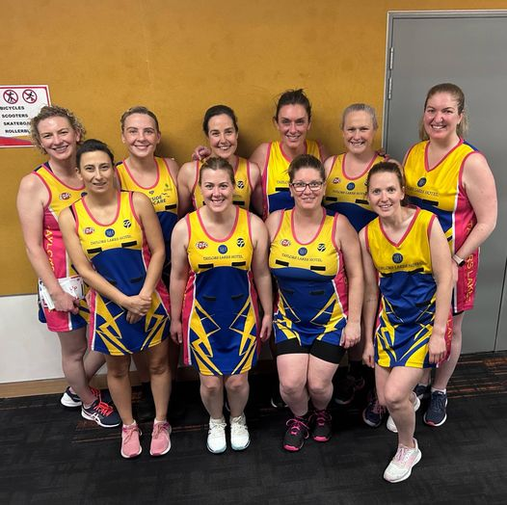
TAYLORS LAKES NETBALL SQUADS. PREMIERS AND RUNNERS UP..

Slide 32


